Slide 1
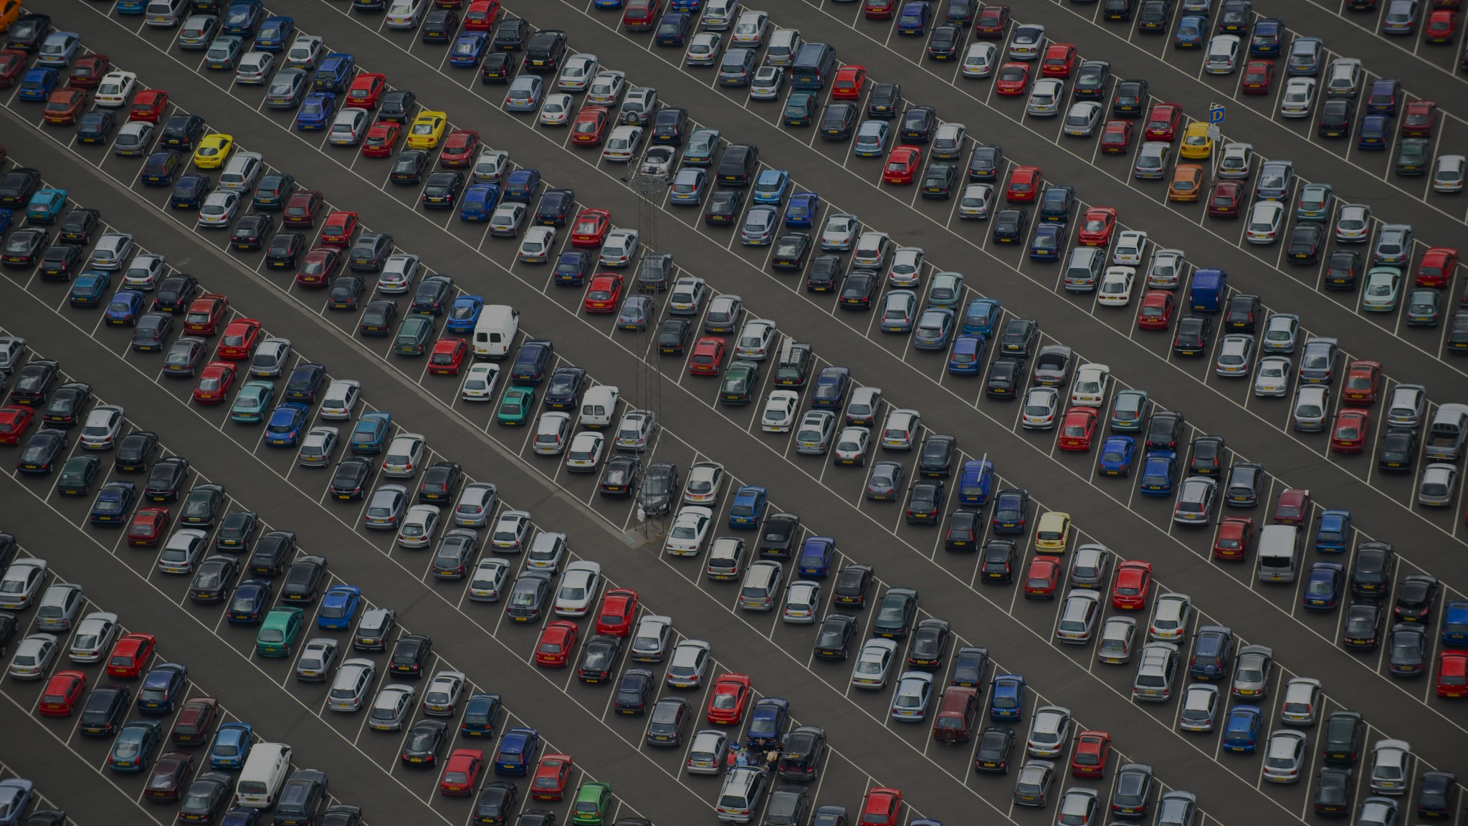
Statistics Final: Car Prices
Eli & Eric

Slide 2
Research question
What factors are most important in determining the price of cars?
Interested in predictability of car price and most impactful factors.

Slide 3
Experimental design
Taking data from Kaggle
35,000+ rows of cars
Scrubbed down to ~25,000

Slide 4
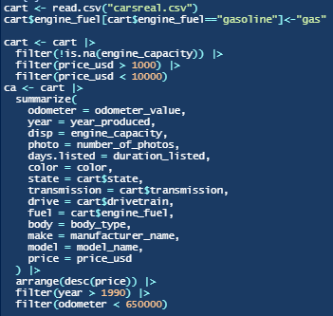
Data scrubbing

Slide 5
Data Summary
 | Odom | Year | Disp | Photo | Days | Price
Mean | 265,080 | 2002 | 2.006 | 9.21 | 79.37 | 4,678
Range | 0 – 646,643 | 1991 – 2019 | 0.200 – 6.800 | 1 - 71 | 0 – 2,232 | 1001 - 9999
 | Color | State | Transm | Drive | Fuel | Body | Make | Model
Unique (#) | 12 | 3 | 2 | 3 | 3 | 12 | 54 | 819
Examples | Blue, black | Owned, new | Mech, auto | Front, all | Gas, electric | Sedan, minivan | Subaru, Lexus | Vivaro, Lancer

Slide 6
hypothesis
H₀= No variable are significant
H_{A}= Some variables are significant

Slide 7
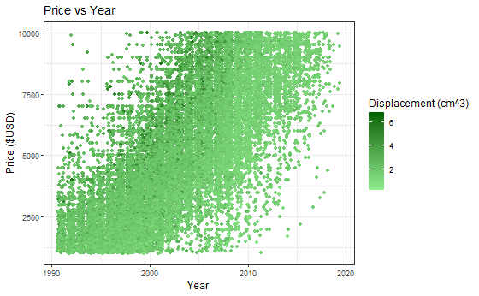
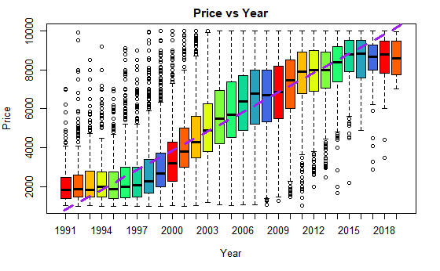
Year
Cor: 0.74833266

Slide 8
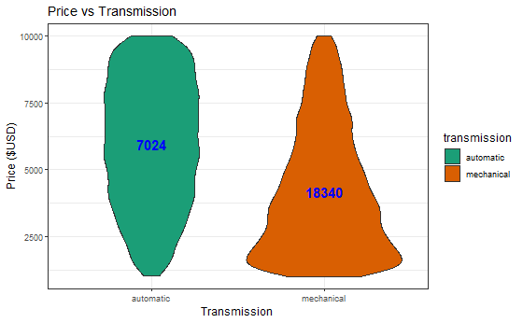
Cor: -0.31762412

Slide 9
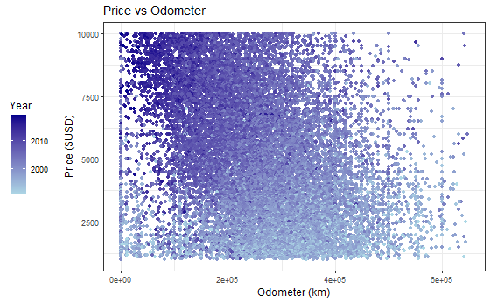
Cor: -0.31644406

Slide 10
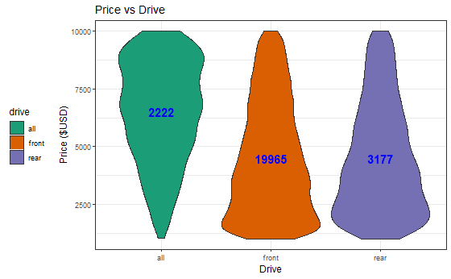
Cor: -0.16162724

Slide 11
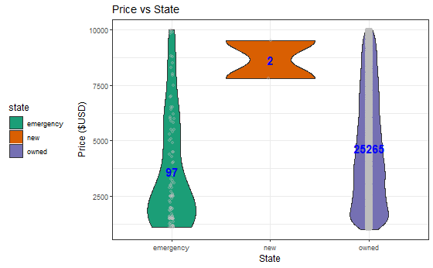
Worst Correlation (excluding model and make)

Slide 12
Results
Factors | Correlation (w/ price)
Year | 0.74833266
Transmission | -0.31762412
Odometer | -0.31644406
Drive | -0.16162724
Photo | 0.15836239
Displacement | 0.15103488
Fuel | -0.05108605
Days Listed | 0.03905872
State | 0.02522637
F-statistic: 182.5
P-value: < 2.2e-16
R-Squared: 0.8637, Adjusted: 0.859
RMSE: 917.3931
Conclusion: At least one of the factors included in data are significant. Based on individual p-values, the most significant factors include odometer, year, state, fuel, photo, and day listed which all have p-values of <2.2e-16.
Interesting: photo factor’s importance

Slide 13
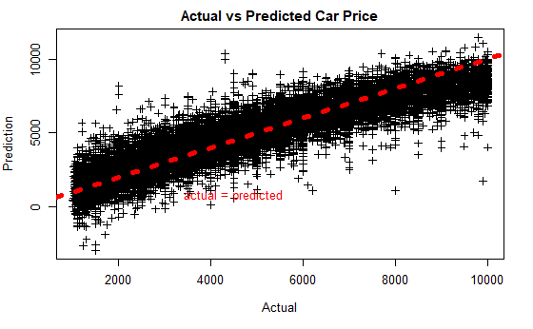

Slide 14
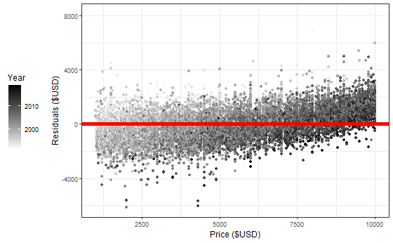

Slide 15
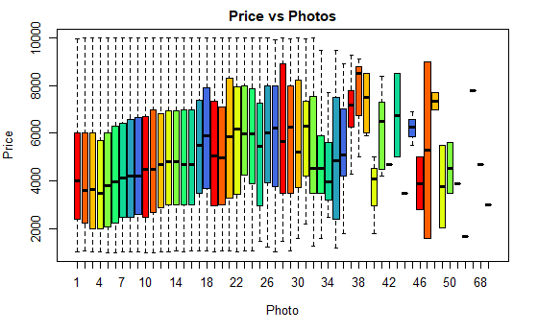
Cor: 0.15836239

